Slide 1
… an introduction
Notes:
Today you are going to play the simulationgame, Europe at Work. There are a few things that are good to know before we start:
Europe at Work is a web-based role play. All students are divided into groups that work with and against each other - some sit in the other classes. You will be mixed across classes and the platform will inform you about you team and your job for the day.
The roles are fictitious, and it is also a fictitious map of "Europe". The aim is not to teach you about European countries, but about how the EU works. One person represents a country or a parliament group. Others get jobs in the EU Comission or in the media. Some have to work for different lobbying interests.

Slide 2
First of all - log in!
Go to the link of the game
Create a user
The game starts in 10 minutes
Notes:
In order to distribute the students optimally, all players must log in 10 minutes before the start of the game. So the first thing teachers should do is to make sure that each student creates a user. Then the students receive a message telling them to wait for the game to start. When the teacher is done with their introduction, everyone can access their screens and start reading their job descriptions.

Slide 3
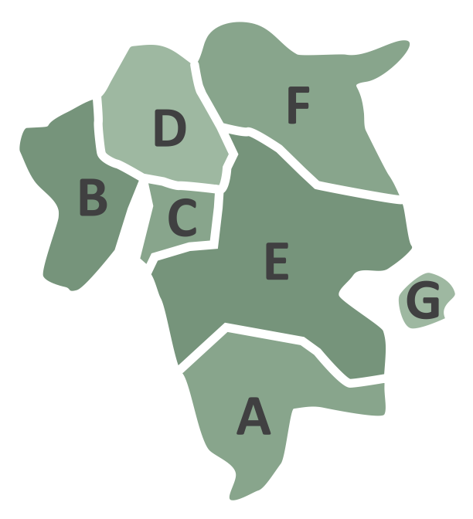
Today we play!
Notes:
This means that today you will be making decisions in the EU - it will be hectic, fun and educational!
You will be divided into teams across all participating classes. Everyone will be given a specific job. The roles are fictional and some of the mechanisms in the EU are simplified in the game. For example, there are only 7 countries - instead of 27 - and they are called A-country, B-country, etc.
You will be assigned a unique and specific job in your team. It is important that you understand your own job well, otherwise it will be impossible for you to fulfill your role in your team and the others rely on you. Ministers are eg. helpless without their counsellors to investigate problems and possibilities for them and to prepare important notes and briefs about them.

Slide 4
Rules for people who want to work in other EU countries
What benefits are workers from other EU countries entitled to?
How should companies be controlled?
How much should be set in the EU and how much in the member states?
When should the legislation come into force?
Notes:
Europe at Work is about negotiating a directive that sets the rules for workers who want to work in another EU country.

Slide 5
The EU-Commission
Sends out a total of 3 drafts of the policy/directive.
Try to find the common ground between different views.
Notes:
The Commission publishes a revised draft of the directive three times during the course of the day. The Commission listens to the arguments of the Member States and the Parliament. The Commission has two opportunities to make amendments to the Directive to ensure that as many as possible will vote in favour of the final Directive.
The Commission attends the meetings of the Council of Ministers and the Labour Market Committee, and it has many staff members who work on relations with the other negotiators. These staff find out who is willing to agree and who is not and who is trying to compromise and give suggestions on how to respond.

Slide 6
The European Parliament
4 EP political groups
Simple majority
BLUE
RED
ORANGE
GREEN
Notes:
There are four political groups in the Europe at Work EU Parliament. Each group is made up of democratically elected politicians from the member states, who come together according to their political convictions. There are representatives of all the political groups in the Labour Market Committee. Together they negotiate the Commission's draft directive. If they can agree, they have a stronger voice against the Council of the European Union (Council of Ministers).
The directive can only be adopted if there is a majority in both the EU Parliament and the Council of Ministers. In the Parliament, a simple majority is required. This means that there must be more votes in favour than against.

Slide 7
The Council of the European Union (Council of Ministers)
D-Land
7 member states
Qualified majority
A-Land
E-Land
B-Land
F-Land
C-Land
G-Land
Notes:
In the Council of the European Union (Council of Ministers) in Europe at Work, the Labour Ministers of all seven Member States have a seat. A qualified majority is required in the Council of Ministers. In Europe at Work this means that at least 4 Member States, together representing at least 65% of EU citizens, must vote in favour.

Slide 8
Media Houses
Scoop Dog Magazine
The Next Europe
Business Now
Notes:
The negotiations in Europe at Work are closely followed by three very different media houses. They publish articles on the blog "NEWstream" and compete with each other for the most interesting stories and to be the first with the latest news. How the media covers the negotiations is important to the followers back kome. They are also the ones asking the Commission, Ministers and speakers in the Parliament Groups questions at the final press conference. What is their stance on the directive? What will their voters back home think about the results? Which strategies worked and which did not?

Slide 9
Lobbying organisations
The Greatest Union
Europäischer Arbeitgeberverband
The Bare Minimum
InCrypted Lagune
Notes:
Europe at Work has four lobbyist organisations. They each represent their specific interests: Trade unions, big business, human rights organisations and a technology company. They all try to influence the negotiations by convincing the negotiators. They do this by offering them their special knowledge and arguments, or even by blocking their opponents.

Slide 10
Einfluss bekommen
More citizens should have the right to work in other EU countries -
No thanks to social dumping...
More economic growth...
Less EU control...
GREEN
Notes:
All groups have certain priorities that they like to see represented in the policy. It is important to raise the priorities in the policy so that they are more emphasised.

Slide 11
Gain the most influence points
IP
(Informal Power)
Notes:
A very important concept is Influence Point - or IP. The team with the most IP wins the game. Roughly speaking, you get IP in two ways:
You can get it from other teams to help them with something. If you agree with another team on a compromise, for instance, they can offer you influence points to back up one of their priorities, as long as it does not go against your own standingpoints, and vice versa.
You can put influence points behind the team's priorities. Later, when a new draft policy comes along, the team gets its ownership back + plus a bonus if it got the Commission to raise the priority to a higher level. Europe at Work means that your team gets as much influence on the directive as possible. You have to pull the policy as far as possible towards your own priorities. This is done through agreements with others who support the same priorities as you. If you move the policy in your direction, you will get more influence points.
In other words: You gain influence points by ensuring that what you prioritise is present in the policy as much as possible. You can also trade influence points and transfer them to other teams. You will all find out more about this when the game starts. The team that raises its IP the most wins the game.
One thing to note is that you will always get your IP investment back - maybe even with a profit.

Slide 12
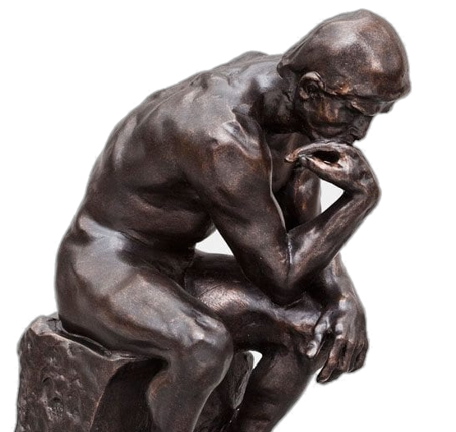
Concentration, please!
Notes:
You will get access to the platform shortly. The first thing that happpens it that yoy will get your job in the team. It is always a challenge to get a new job. Therefore, spend 5-10 minutes to immerse yourself in it - so that you can play better afterwards. Each of you will be given a specific task to do for the team and you need to make sure that the others in the team understand what you can contribute. So read your job description - and look at the different functions that are on the screen.

Slide 13
Ready - set - go!
Påvirk direktivet
Notes:
Have fun... And remember to keep an eye on the news on your screen while you're out and about so you don't miss anything important! Remember - it is fun to play, but we do not play for fun ;)

